Slide 1
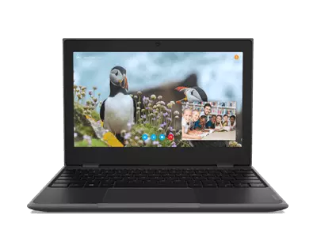
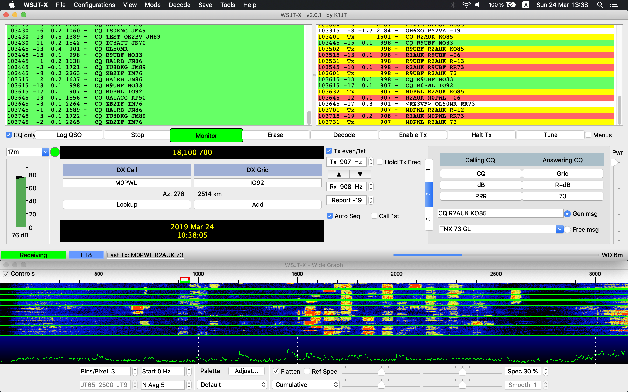
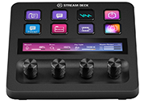
Wfview Client & WSJT-X Configuration IC-7300
IC-7300
WFVIEW SERVER
(REMOTE)
WFVIEW CLIENT
(LOCAL)
STREAM DECK PLUS
KA8JMW 1-31-2024

Slide 2
Download & Install a Virtual Audio Cable
FREE for both Windows & Mac
VB-Audio Virtual Apps

Slide 3
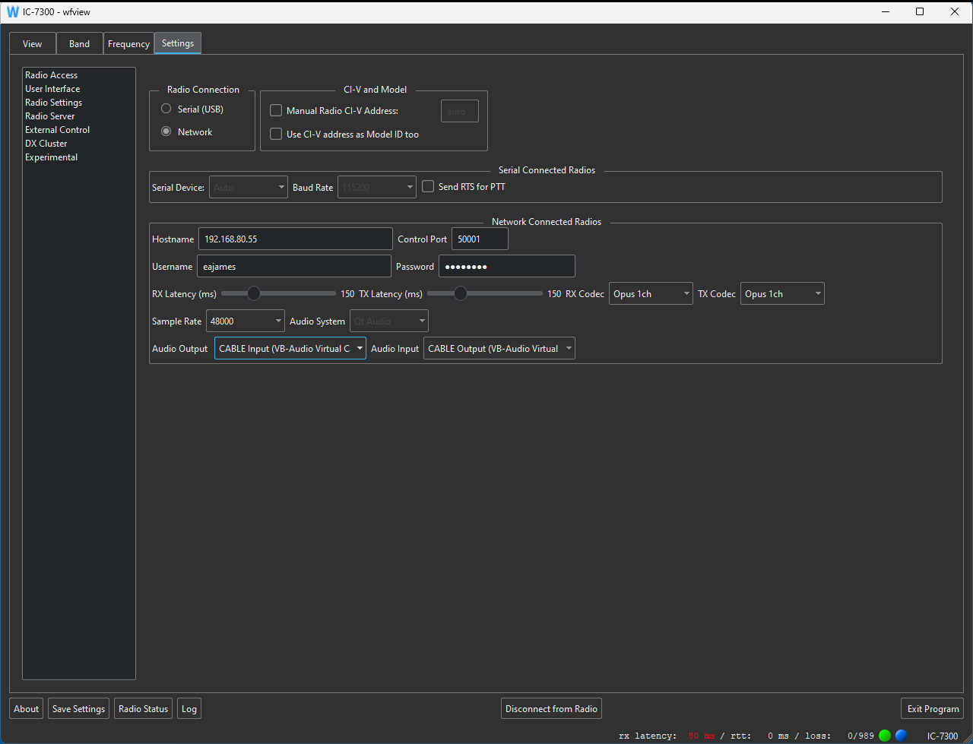
Wfview settings
Select Network.
Server IP address or hostname.
User login credentials.
If received audio “stutters”,
then increase RX Latency.
Set audio to use virtual audio cable.
Use Opus 1ch.
To apply settings, Disconnect & the Reconnect to Radio.
After changing any settings, be sure to save them.

Slide 4
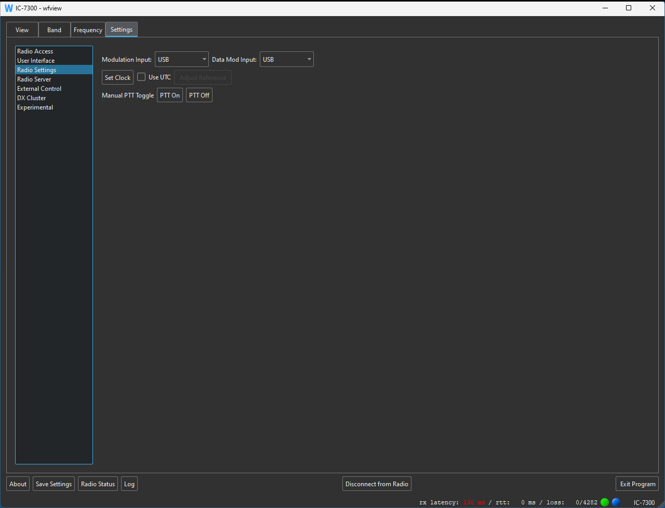
Set Modulation Input & Output
to USB.

Slide 5
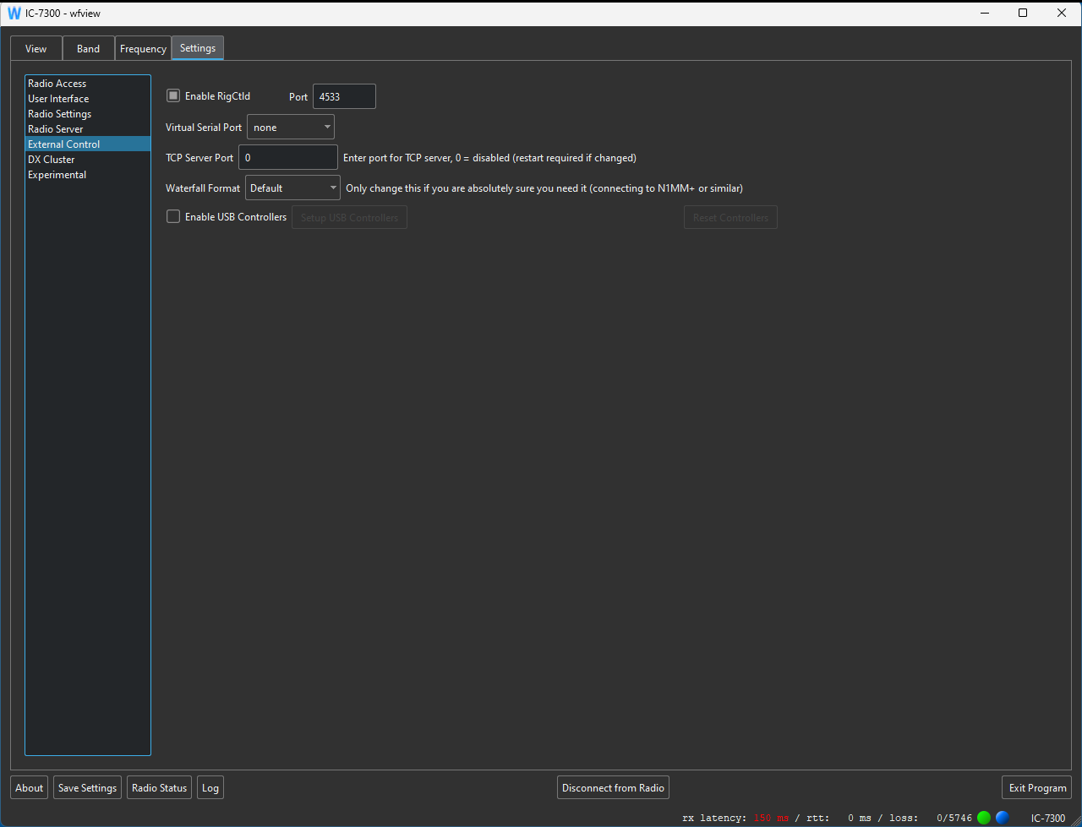
Enable RigCtld,
This will allow WSJT-X to control radio.

Slide 6
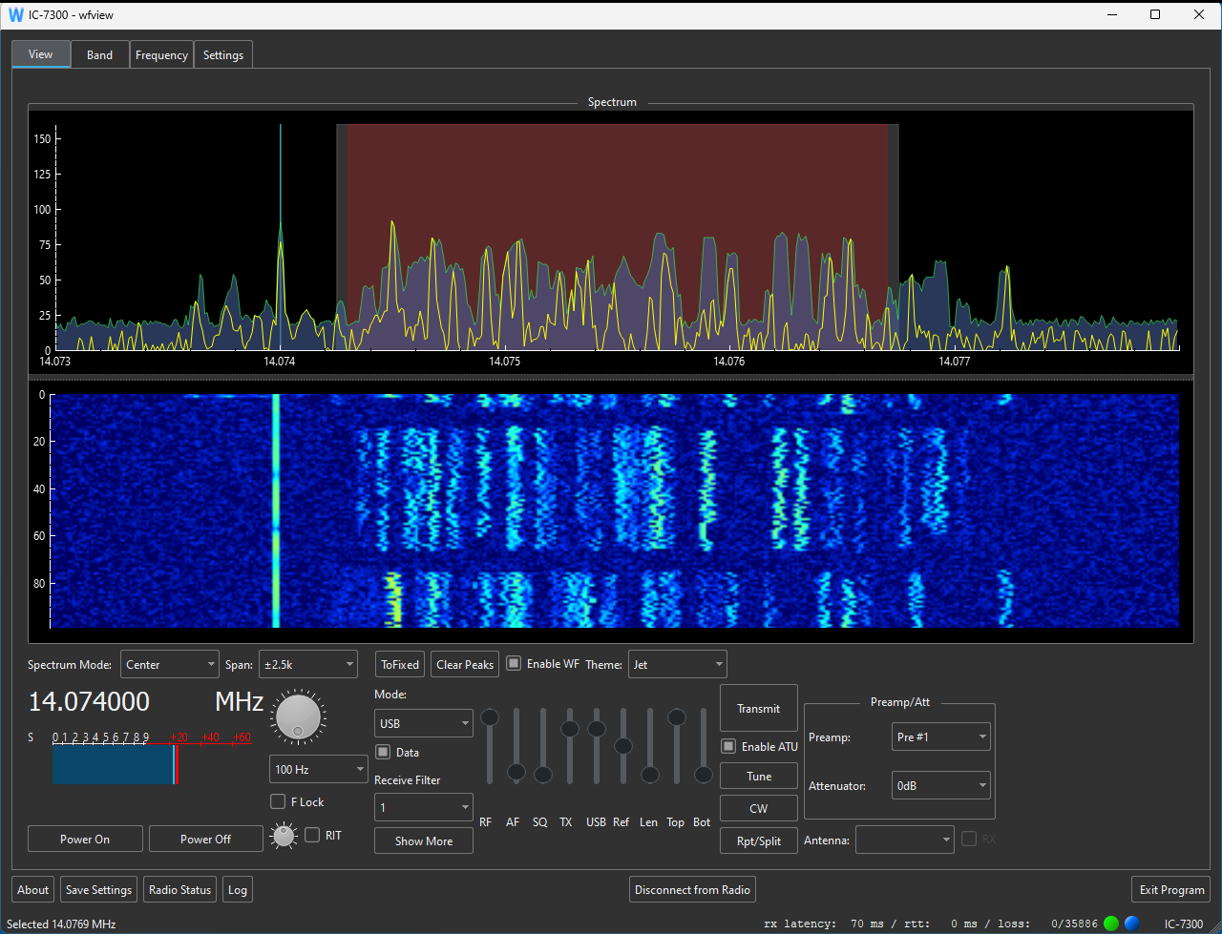
Reduce TX Power
to 80%.
Enable ATU.
Set Data mode
Retune antenna whenever you change bands.

Slide 7
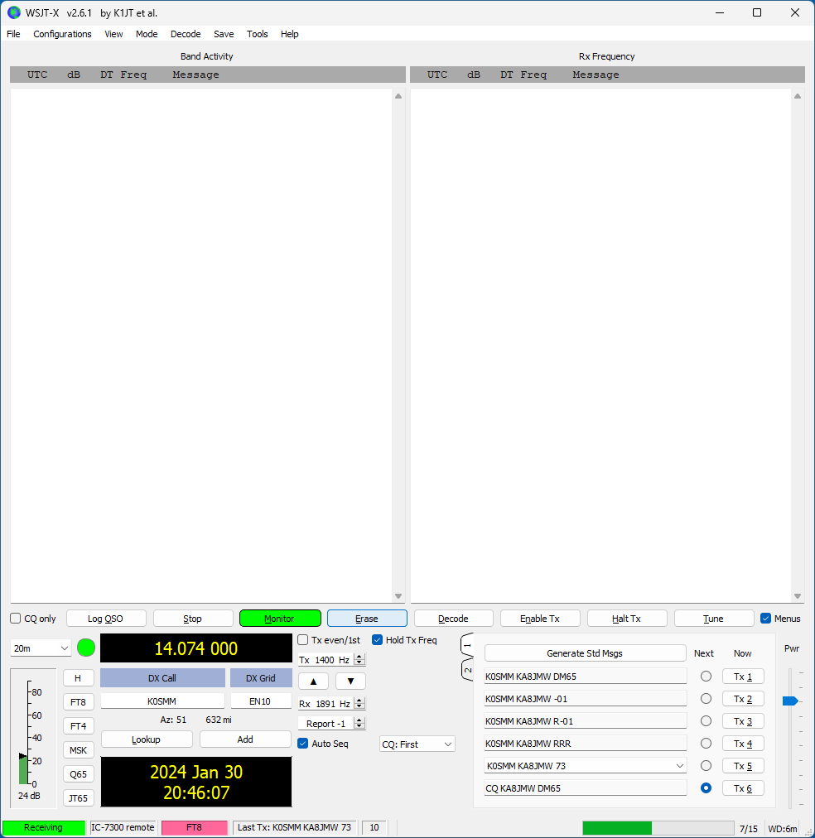
WSJT-X settings
Create a new Configuration named
“IC-7300 Remote”

Slide 8
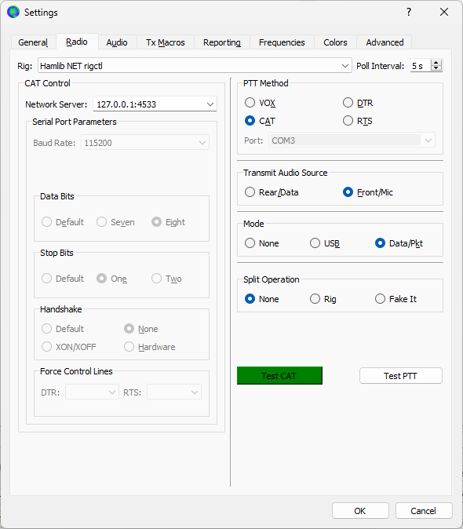
This will allow WSJT-X
to control radio.
Once all settings have been made, Test CAT.

Slide 9
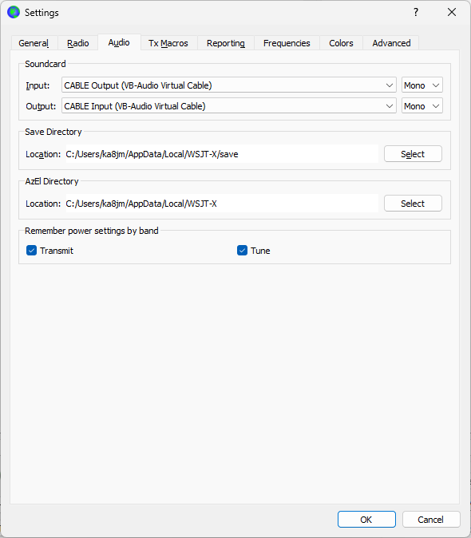
Use the Virtual Audio cable
For Input & Output.

Slide 10
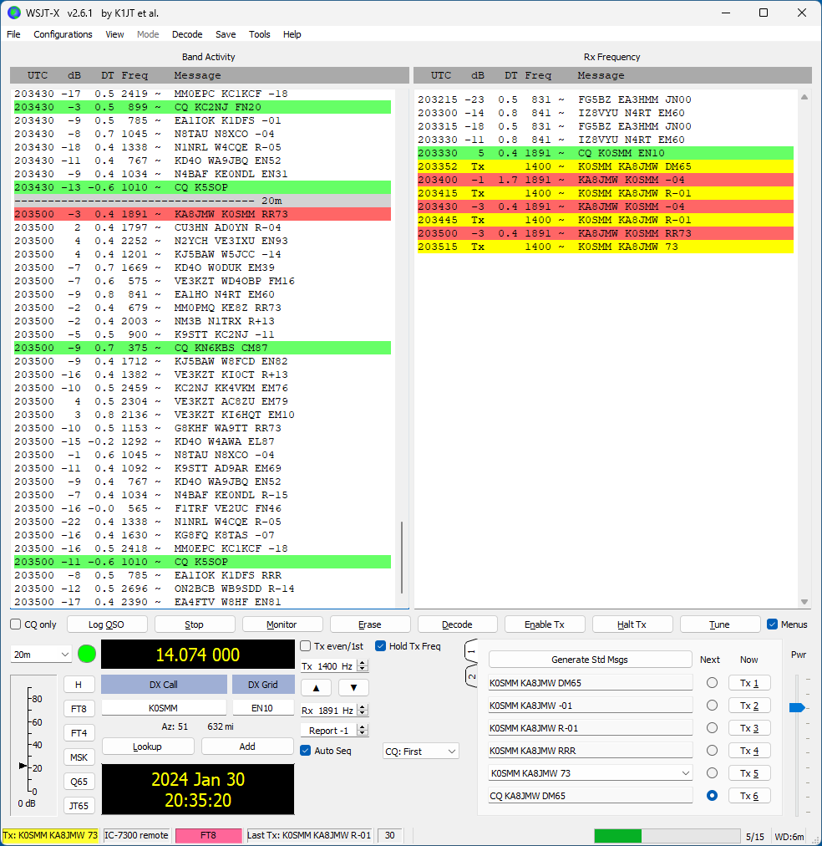
WSJT-X In action

Slide 11
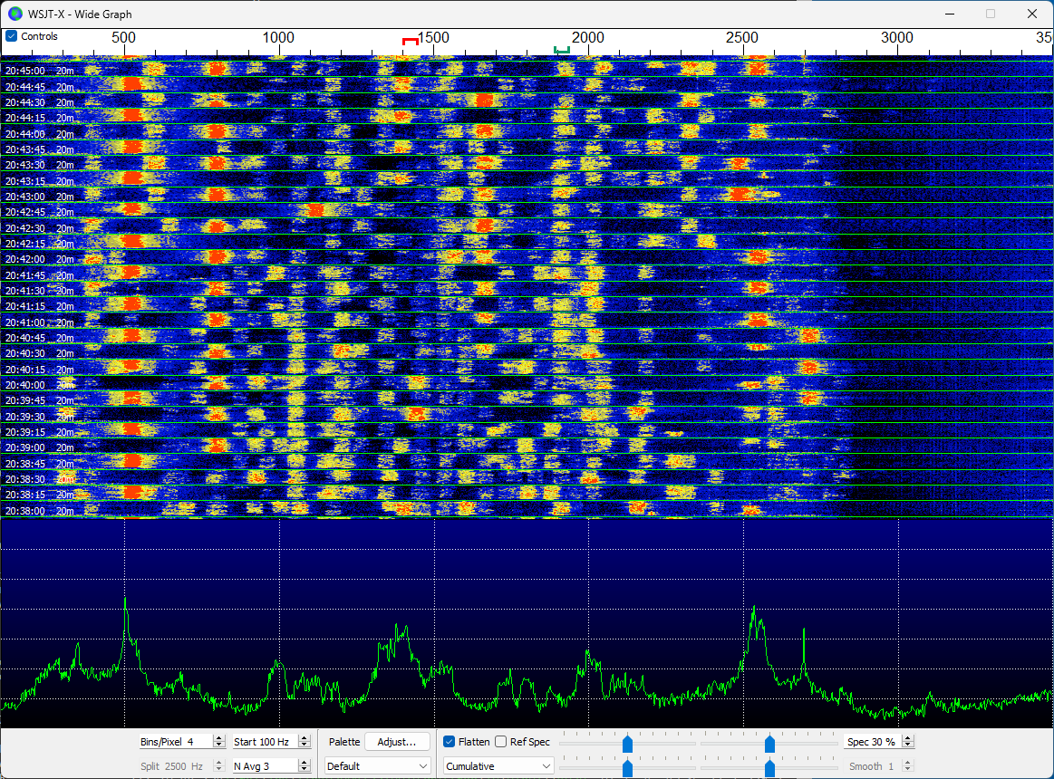

Slide 12
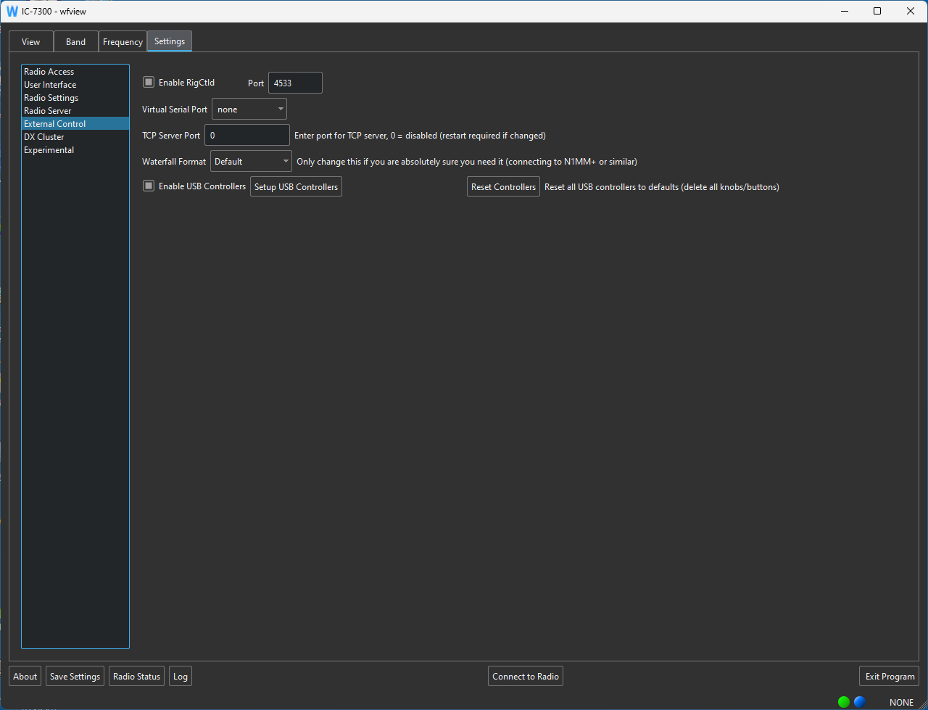
Stream Deck Setup
Enable USB Controllers.
Select to
enter
Stream Deck
Setup.

Slide 13
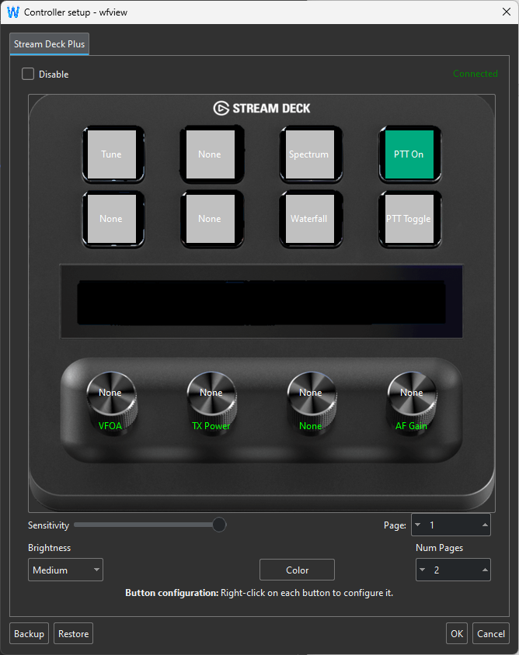
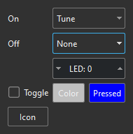
Editing Stream Deck Button Functions
Right Mouse Click over a button to edit it’s function.
A dialog box will then popup. Select and save the button settings.
Knob functions can be similarly assigned.
Multiple pages of functions can be created.

Slide 14
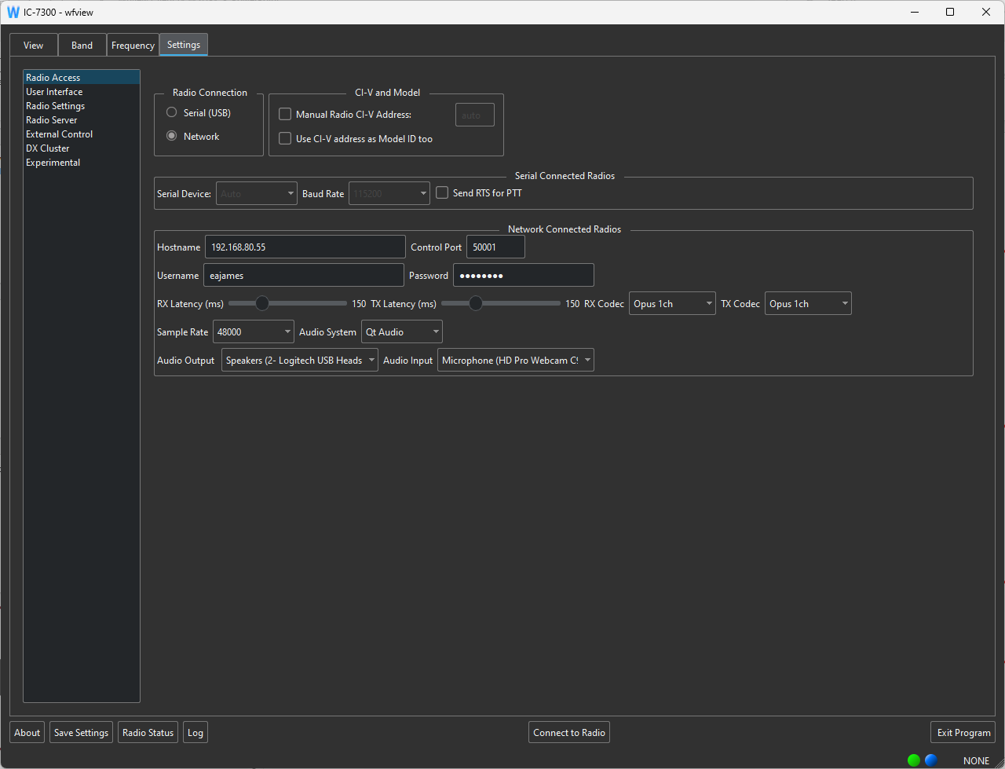
SSB operation with Wfview
If received audio “stutters,
then increase RX Latency.
Set audio to use USB Headset.
To apply settings, Disconnect & the Reconnect to Radio
After changing any settings, be sure to save them.

Slide 15
Wfview Rpi server config
For
IC-7300
IC-7300 config selections

Slide 16
Set Modulation Input & Output
to USB.

Slide 17
IC-7300 config selections

Slide 18
IC-7300
RX Audio Input
TX Audio Output
configuration selections

