Slide 1
Antenna Tapas
March 8, 2025
Doug Sharp, K2AD

Slide 2
Antenna Tapas – What the heck?!?

Slide 3
Big antennas are great! But Tapas are “small plates” – so Let’s talk about smaller antennas you can build and install at your QTH
W2PV Big Birtha
120 ft rotating self-supporting tower

Slide 4
Antenna Tapas - Small Plates to talk about today
Cheap VHF Yagis
80 Meter sloper
Tuning Cushcraft Yagis and Verticals
Six Meter Antennas
Inverted L
Effect of HAGL on antennas

Slide 5
Cheap VHF / UHF Yagis and More …

Slide 6
Cheap VHF / UHF Yagis
Big antennas are very nice!
But sometimes “less is more” (to steal the Linux phrase)
Your first Tapa begins here … www.wa5vjb.com

Slide 7
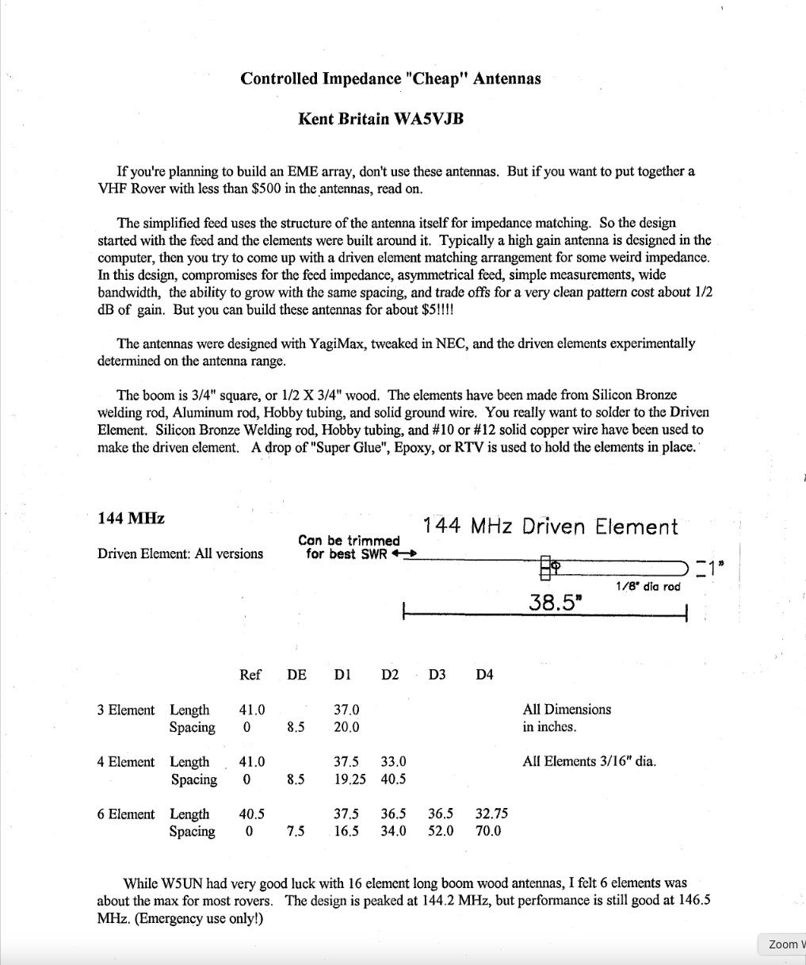
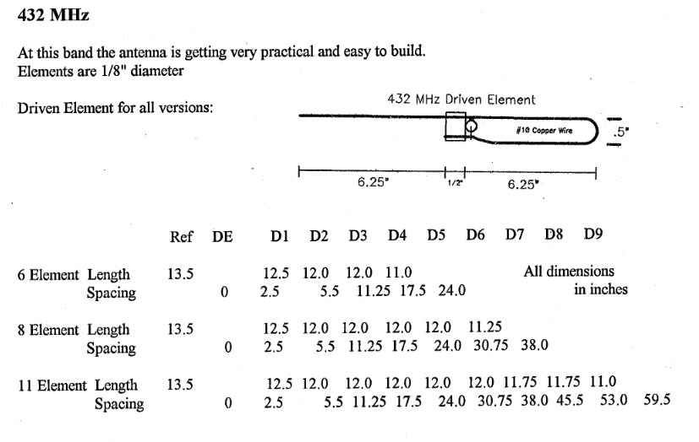
Cheap VHF / UHF Yagis
Anyone interested in a $5 antenna?
Easy and Cheap to build!
You will not be LOUD! But you will make contacts.
Better than a wet noodle!
Can use either vertical or horizontal polarization
Vertical for FM
Horizontal for SSB/FT8
Thanks to my friend Kent, WA5VJB for this article
https://wa5vjb.com/yagi-pdf/cheapyagi.pdf

Slide 8
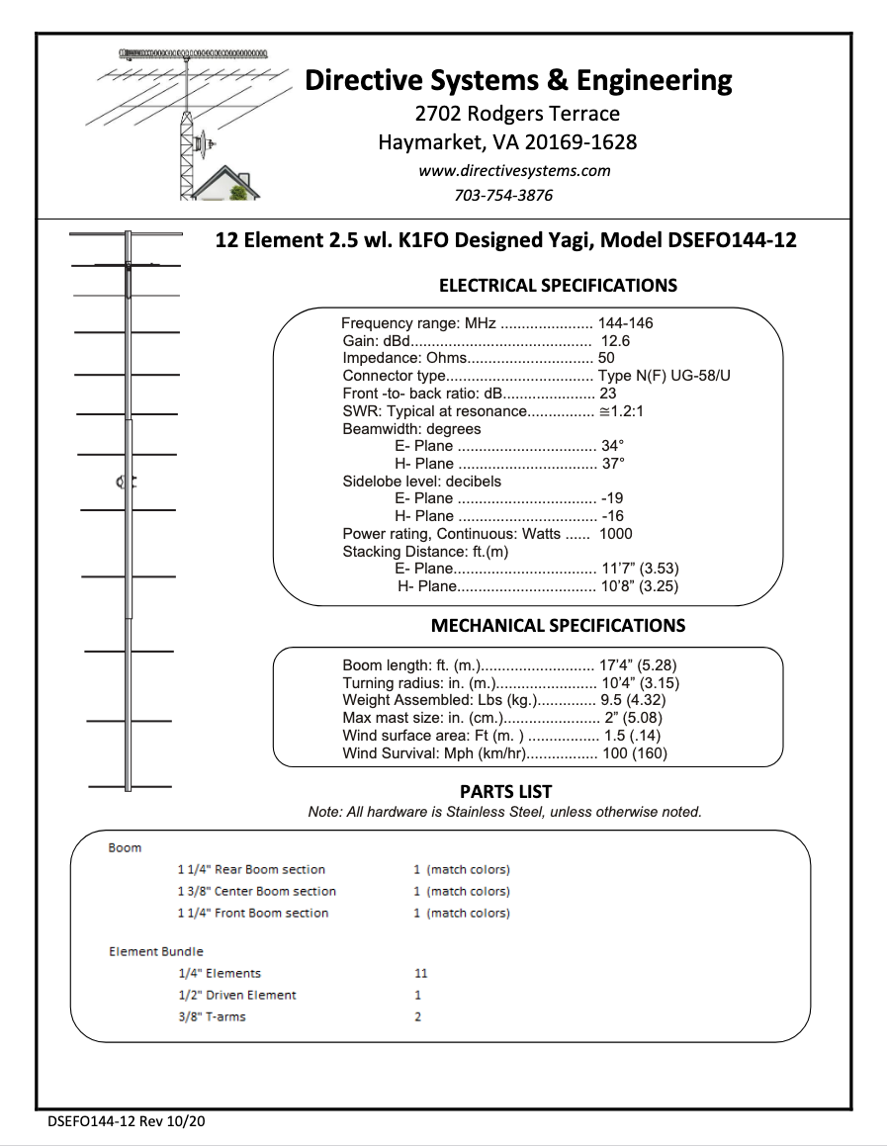
A slightly larger portion Tapa – bigger VHF / UHF Yagis
A commercial “ham product” to compare
Directive Systems
Was in Maine founded by Dave, K1WHS
Now owned and operated by Terry, W8ZN in Northern VA
M2 Antenna also makes nice antennas
Excellent yagis at a good price
$220ish
$310ish

Slide 9
Omni and limited Directivity on 50 and 144 MHz

Slide 10
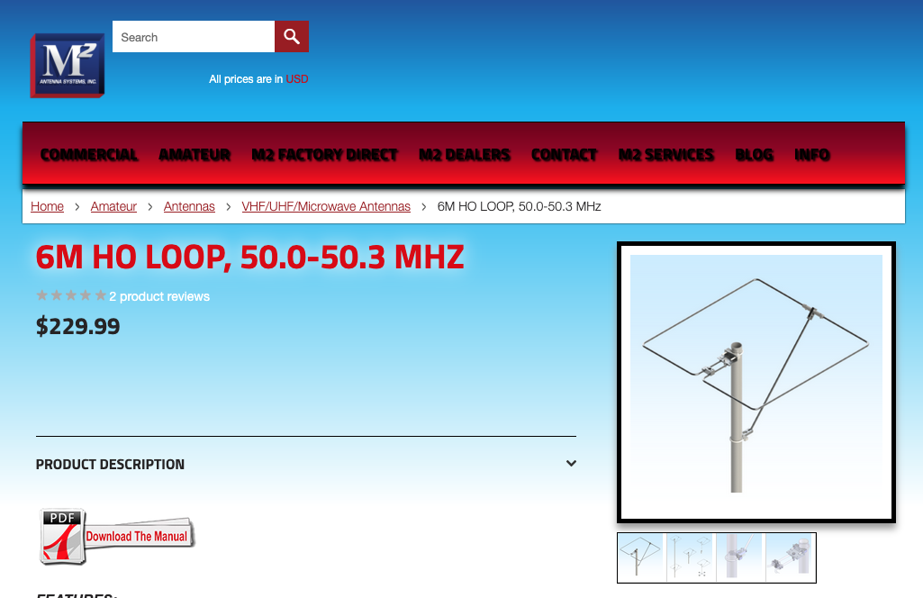
6 meter halo and Moxon
Do you have room in your back yard for one of these?
You can even call it a TV Antenna to placate your HOA
Six Meter Moxon Antenna
Check out the proceedings article from the 2014 Central States VHF Society Conference
A Reduced Size Six Meter Moxon for Roving by Jon Platt, W0ZQ
Six-meter Halo Antenna
Also available for two-meters

Slide 11
75 meter sloper antenna

Slide 12
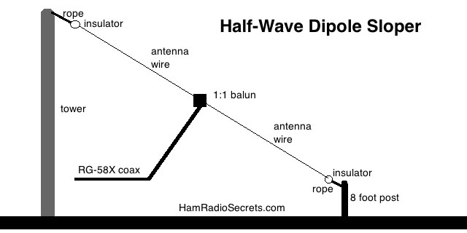
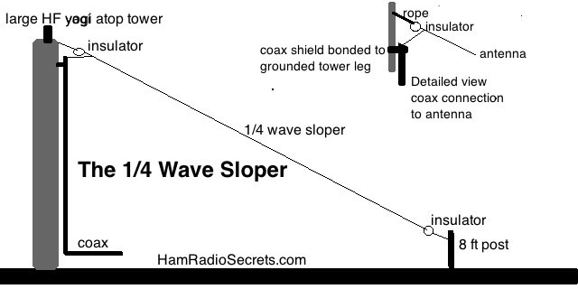
A Sloper antenna for 80 / 75 meters
The ARRL Handbook (not the ARRL Antenna Book) has a nice article about 80 meter quarter wave Sloper antennas
A sloper is essentially a dipole mounted at a 45 degree angle
Directional antenna
ARRL Handbook suggests that some “top hat” capacitance will improve performance
So let’s use our Tri-Band yagi as a top hat
We can install multiple sloper antennas (NE and SW) to obtain directivity
Or possibly two sloper antennas (NE and SW) with an Inverted Vee at 90 degrees?
Graphics stolen from HamRadioSecrets.com

Slide 13
Someone gave me a cushcraft A3s tri-bander
Don’t look a gift horse in the mouth … but

Slide 14
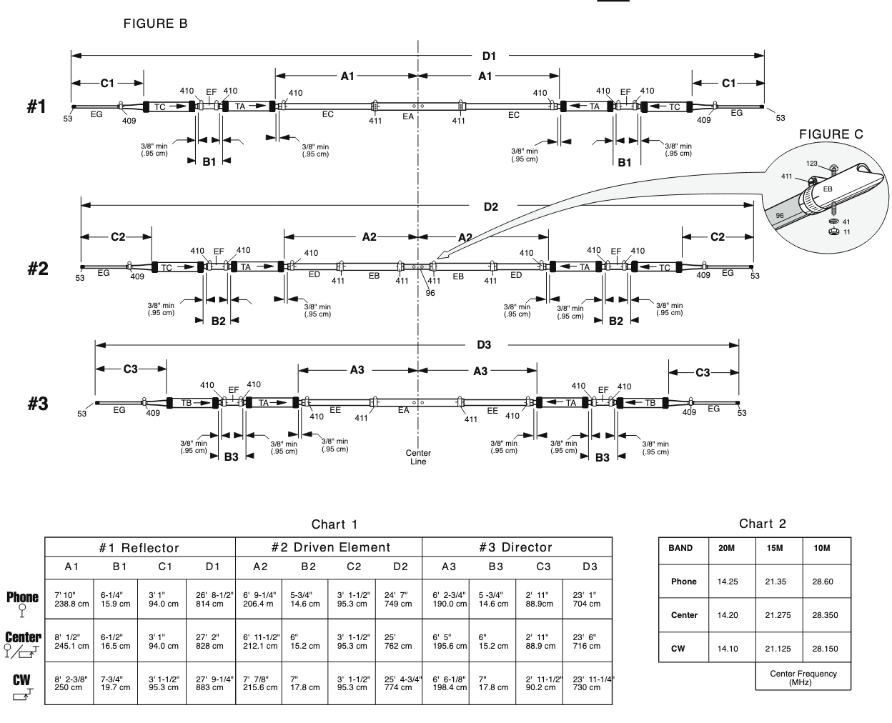
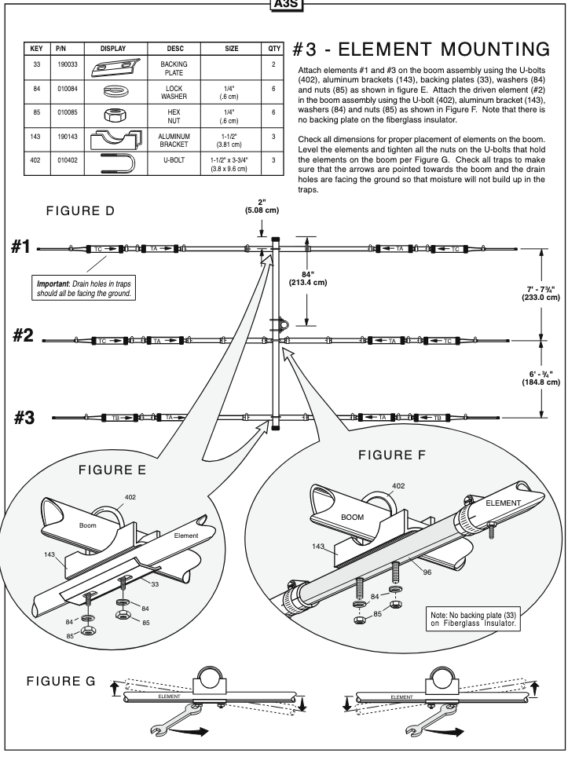
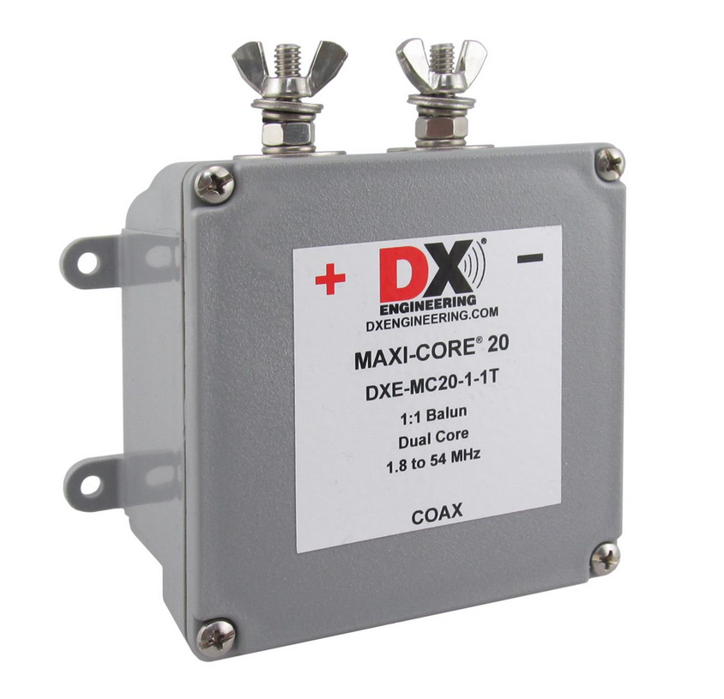
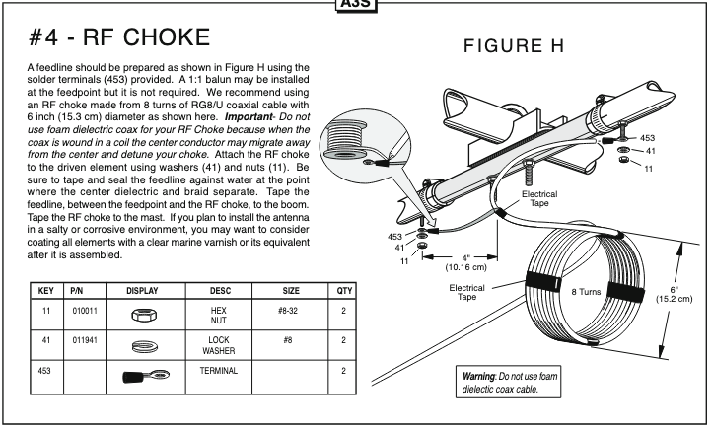
Cushcraft HF Yagis – A3S
The Cushcraft (was sold by MFJ) is a good HF Tri-band antenna
Optional 40 meter (driven element only) kit available
These antennas work well … assuming they are properly manufactured and built
(We have had some issue with improperly manufactured traps.)
Element Lengths - Measure twice, cut once.
Element spacing and boom mounting method is important.
Use a coax balun, or try a balum from DX Engineering.

Slide 15
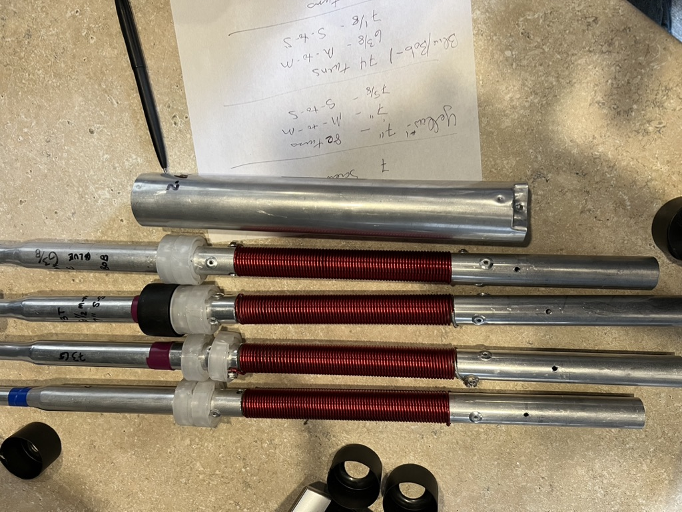
Cushcraft HF Yagis – A3S
I bet that our traps were built during Covid
Out of six traps for 40 meters, we had four (yes 4!) different lengths and turns
Check out this blog regarding re-building the traps
https://wb4iuy.blogspot.com/2019/01/a3s-assembly-notes-for-friend.html
Element Lengths - Measure twice, cut once.

Slide 16
VHF UHF antennas is bigger better?

Slide 17
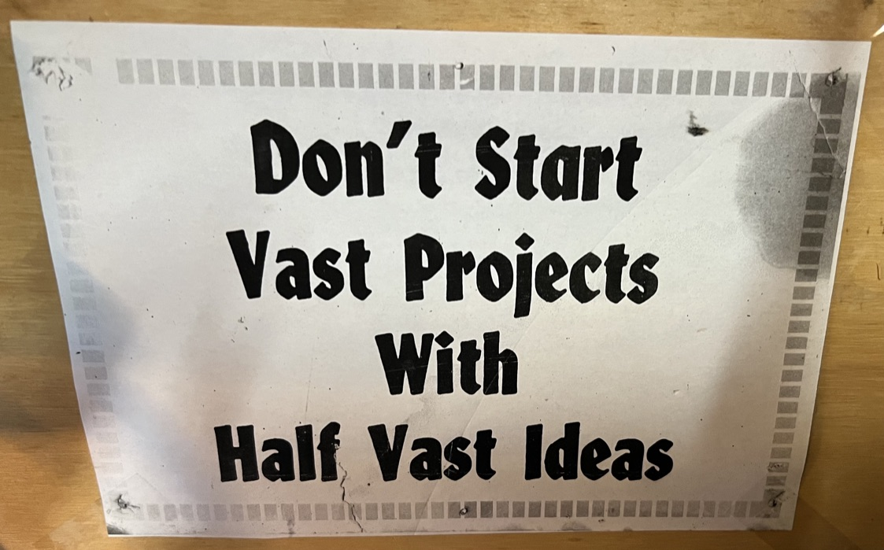
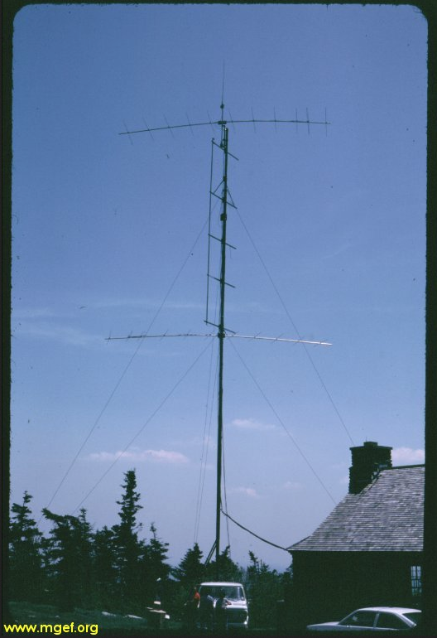
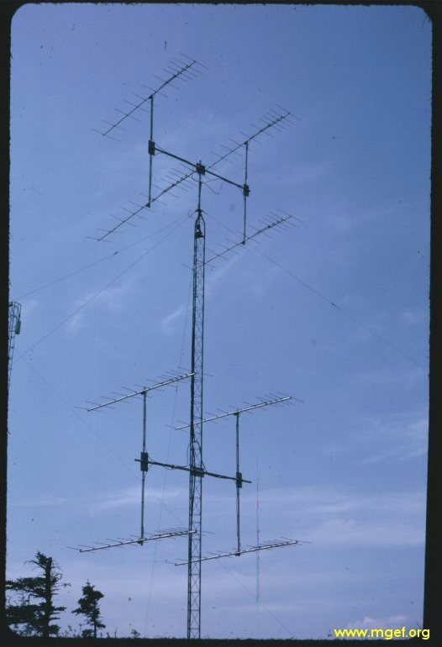
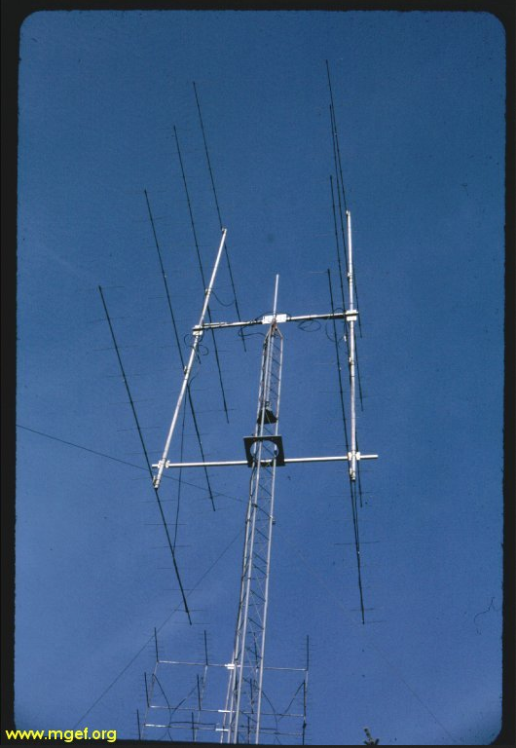
Bigger is not always better – A look at W2SZ/1 around 1980
W2SZ/1 50 MHz Stack
6 / 6 elements at 44 and 88 ft
W2SZ/1 144 MHz Stack
8 x 12 elements on 50 ft rotating tower
W2SZ/1 222 and 432 MHz Stack
8 x 16 el 222 MHz, 16 x 8 el 432 MHz

Slide 18
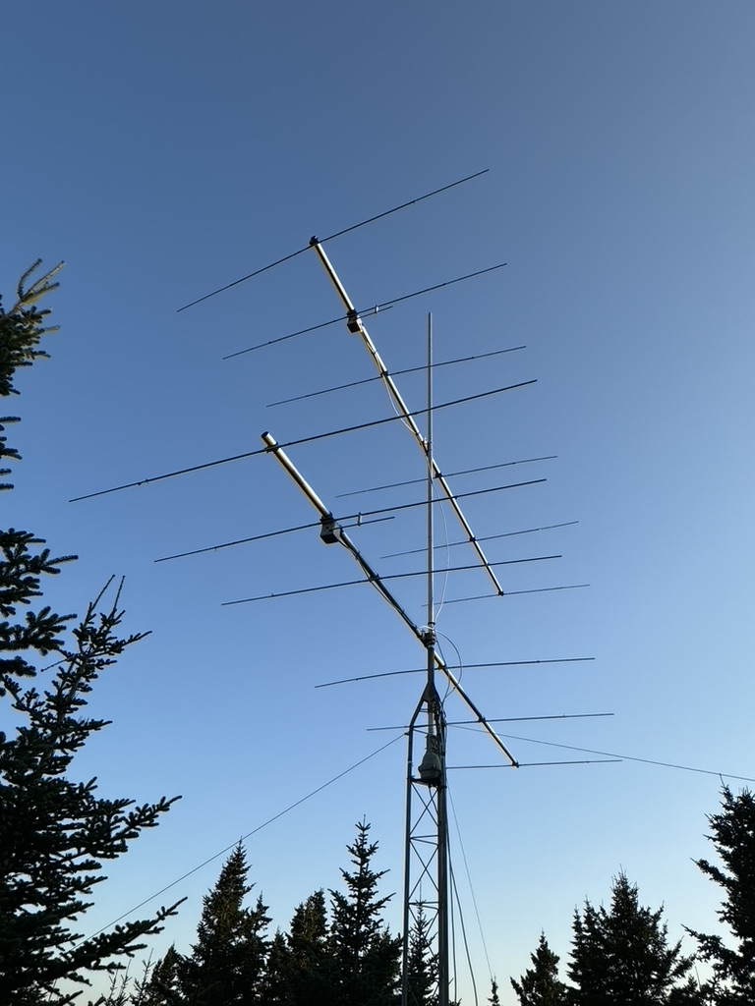
Bigger is not always better – These were just too big
Antennas were very narrow beamwidth and hard to aim at distant stations
High antennas = low radiation angle
We could work Europe and West Coast on these antennas … but we could not work the locals
Our solution – lower and smaller antennas
Design for cleanest pattern versus maximum gain
Position on mountain to achieve ground gain
Much easier to erect for a contest weekend
More appropriate for a home station!
The old W2SZ/1 6-Meter Main Array
The new W2SZ/1 6-Meter Main Array

Slide 19
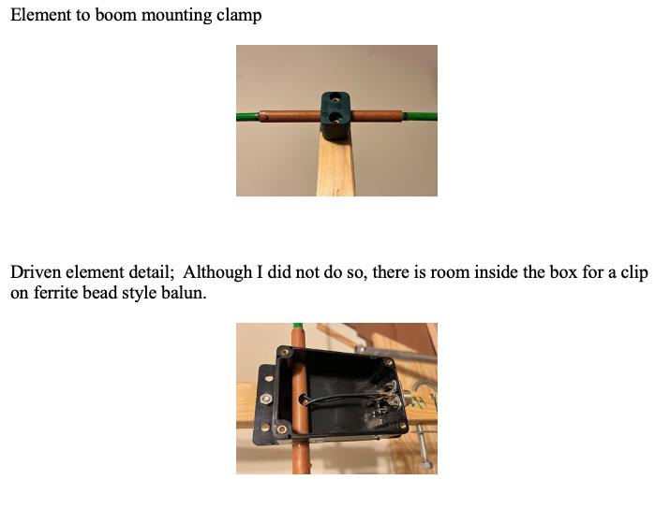
6 meter tomato stake yagi
This Tapa is tomato based! The Tomato Stake Antenna
Designed and built by Fred Lass, K2TR
Fred is a charter member of our Mount Greylock Expeditionary Force (MGEF) VHF/UHF Contest Group – W2SZ/1
Many years back, Fred noted that W2SZ had a “hole” in our grid map at approximately 700 miles
Our antennas were too high and too low angle to work those stations
Fred designed this “cheap yagi” by adapting published designs for “clean yagis”
The most expensive components are the fiberglass tomato stakes (from Amazon) and the molded plastic clamps
Used with permission from Fred Lass, K2TR

Slide 20
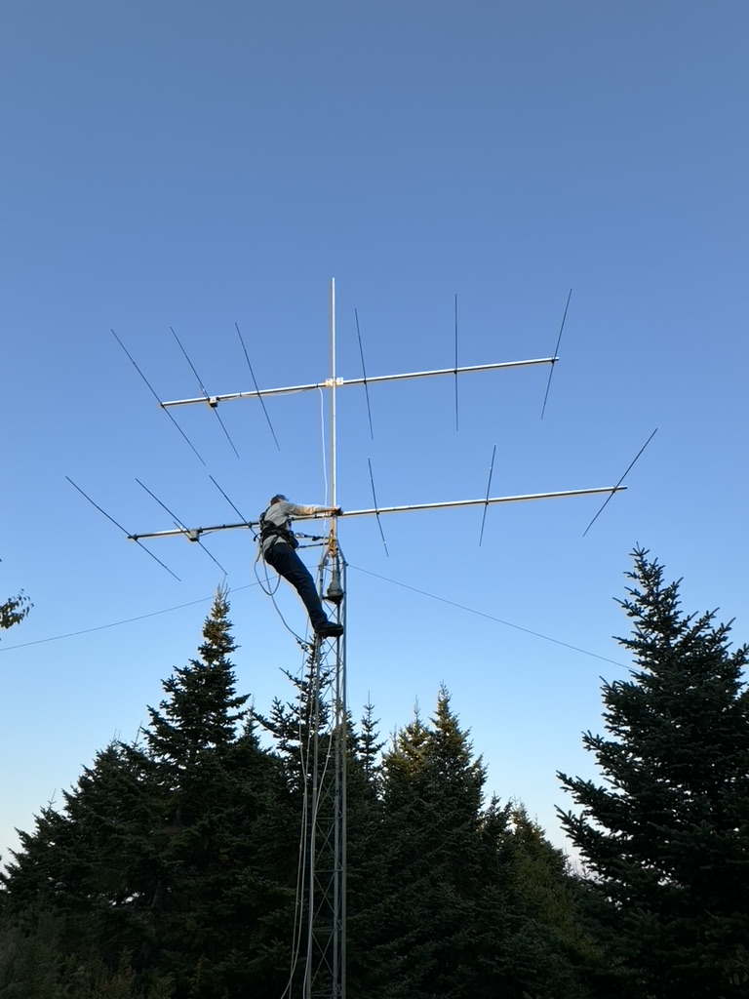
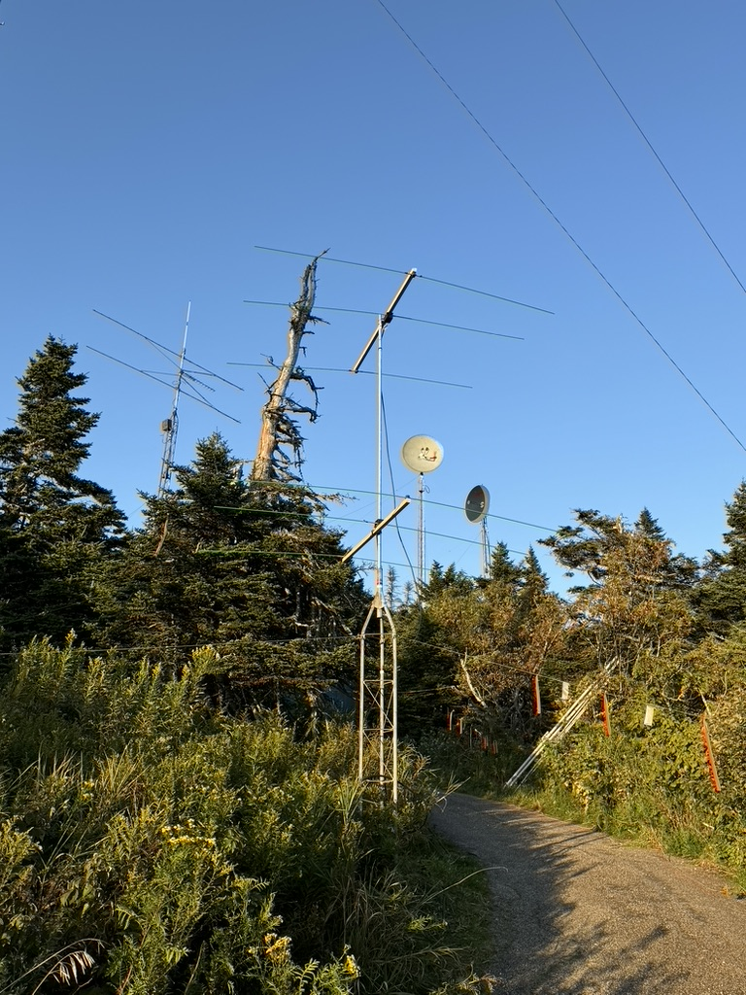
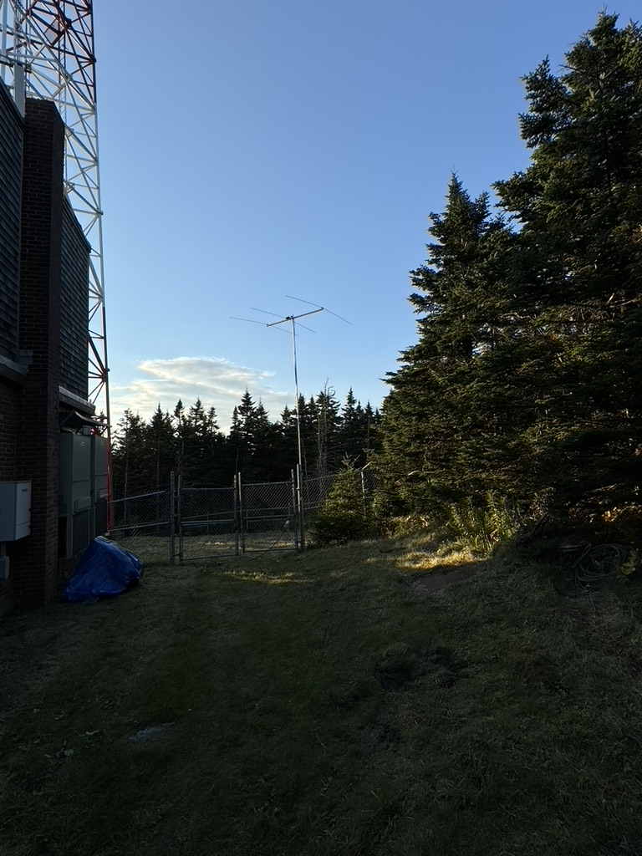
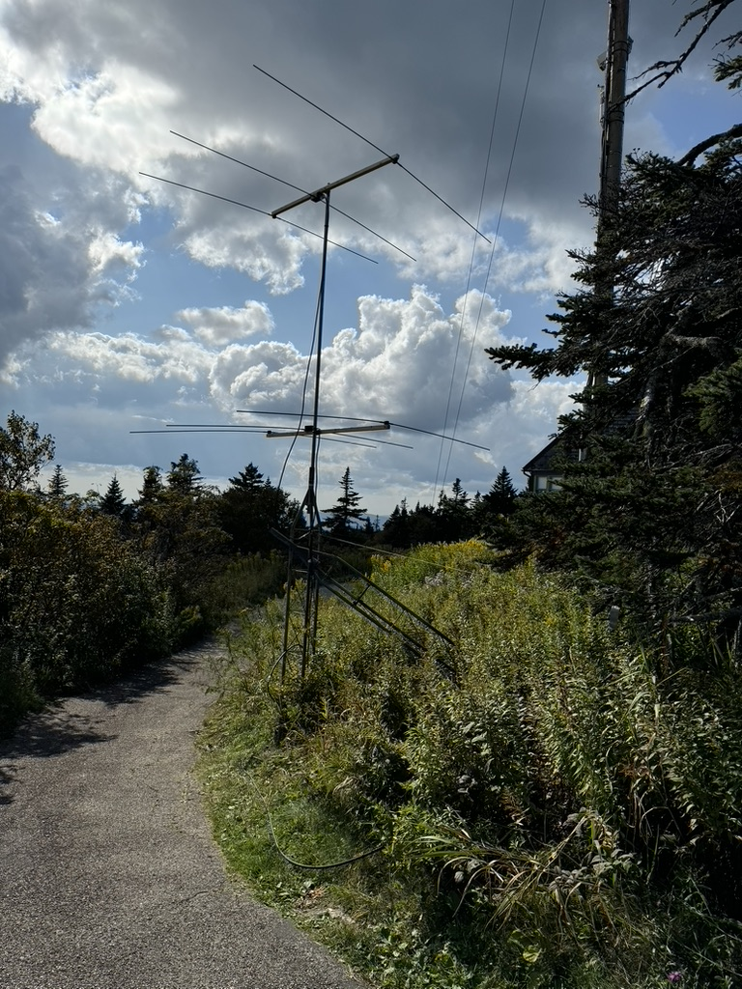
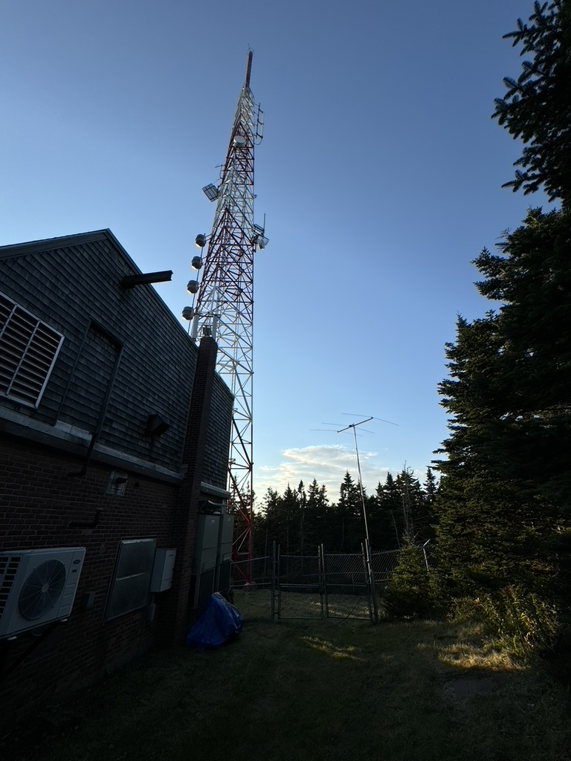
Six Meter Low yagis – The tomato stake yagi deployed
Primary Stack (6 ele / 6 ele) with optimized F/B and F/R with full rotation
Tomato Stack #1 low to ground, fixed pointing, located to achieve ground gain to Southwest
Tomato Stack #2 low to ground, fixed pointing, located to achieve ground gain to West / Northwest …
Typical Configuration
Primary Stack for SSB/CW
Tomato Stack #1 for FT8 to SW
Tomato Stack #2 for FT8 to W and NW
Primary Stack
6 el / 6 el on mountain peak
Tomato Stack #1
(before modification)
Tomato Stack #2
Tomato Stack #1
(after modification)
Tomato Stack #2
Alternate view

Slide 21
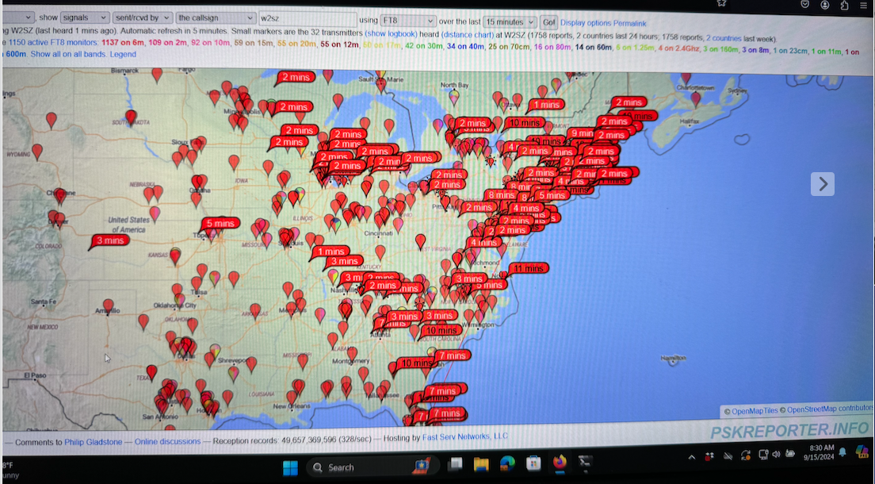
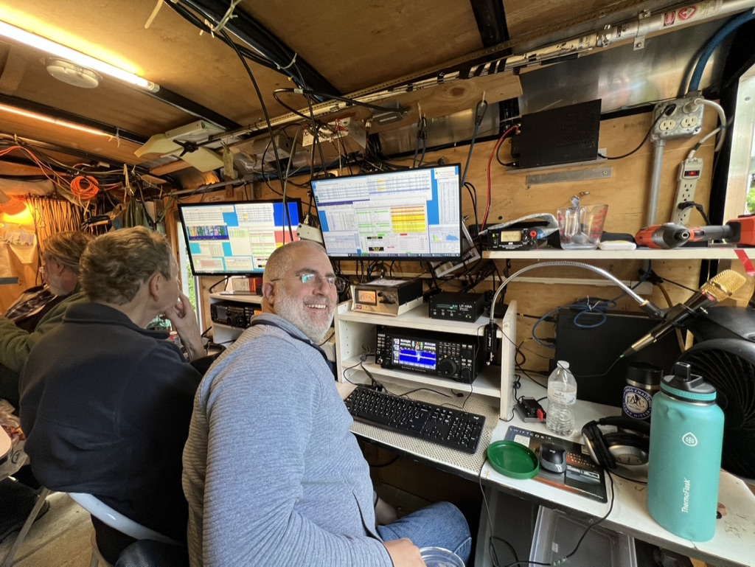
W2SZ/1 – FN32jp Mount Greylock, MA
Calling CQ on FT8 using the SW pointing Tomato Stake Yagi
We are being heard … but mostly unattended stations. ☹
W2SZ/1 – 50 MHz K2TR (left) and K2AD (right)
ARRL September VHF QSO Party 2024
We predicted Trans Equatorial (TE) propagation … we pointed the Primary Stack south and worked South America
When in doubt, call CQ!

Slide 22
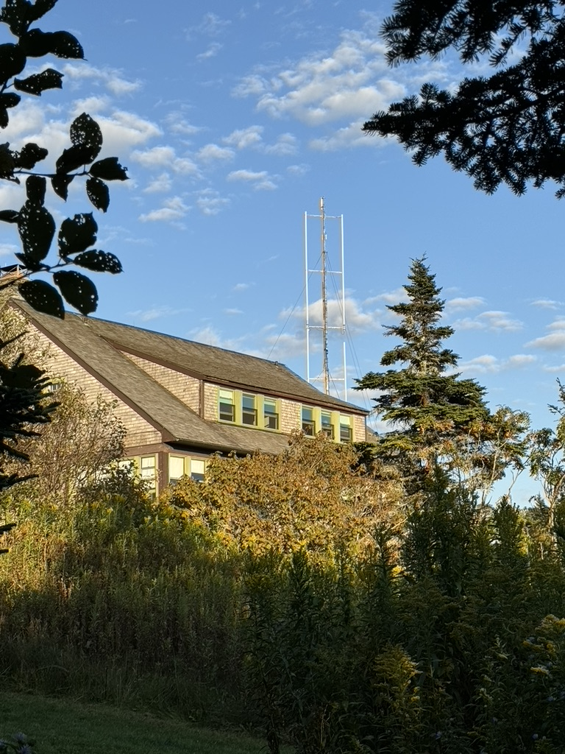
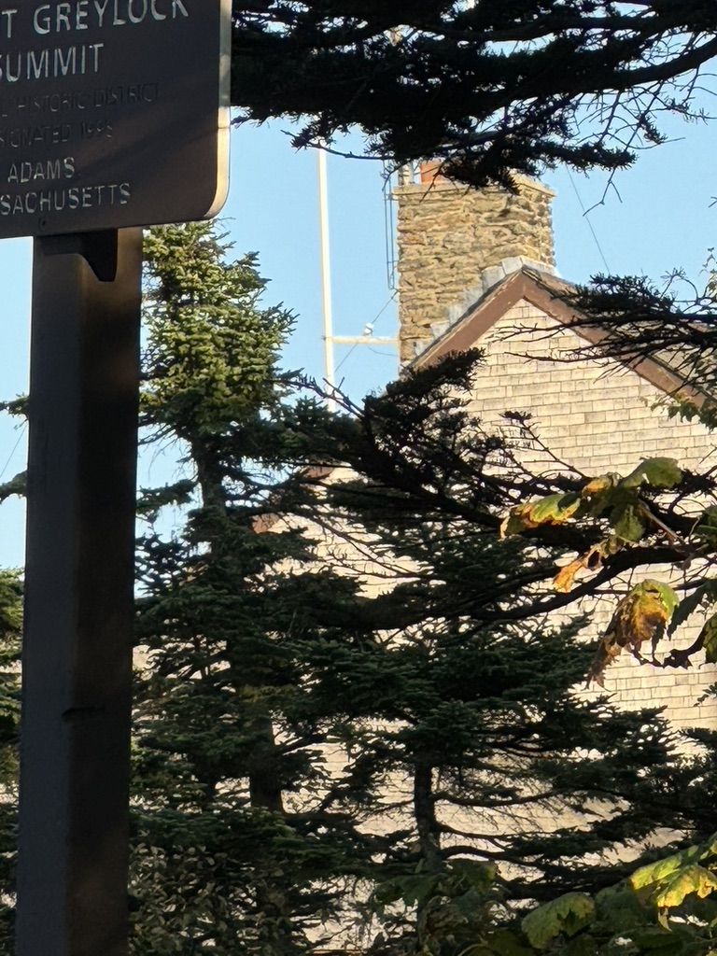
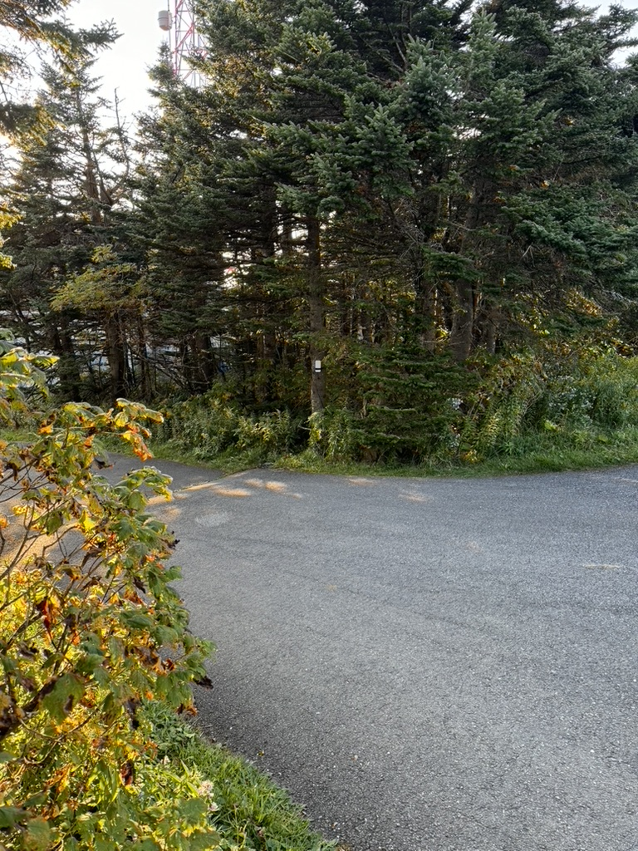
A throwback to last month – remote stationS
Remote Station 1 approx. 500 feet WEST from the Primary
Elecraft K3 or Yaesu FT-DX10 with KPA1500 amplifier
Remote Station 2 approx. 500 feet SOUTH from the Primary
Yaesu FT-DX10 with Homebrew 1500w amplifier
60 GHz link
Main Station 6/6 Stack
Remote Station 1
Remote Station 2
60 GHz link

Slide 24
I’ll take, “HF Antennas for $800 Alex”
What is something other than a dipole

Slide 25
Inverted L
I plan to install an Inverted L at my new QTH
Vertical to the peak of the two-story house
Horizontal to a tree about 150 feet away
Antenna tuner outside house at ground level
At least four ground radials
Let’s see how it works?
Wire is (somewhat) cheap and easy to build

Slide 26
The higher the antenna the better?
Well, sometimes

Slide 27
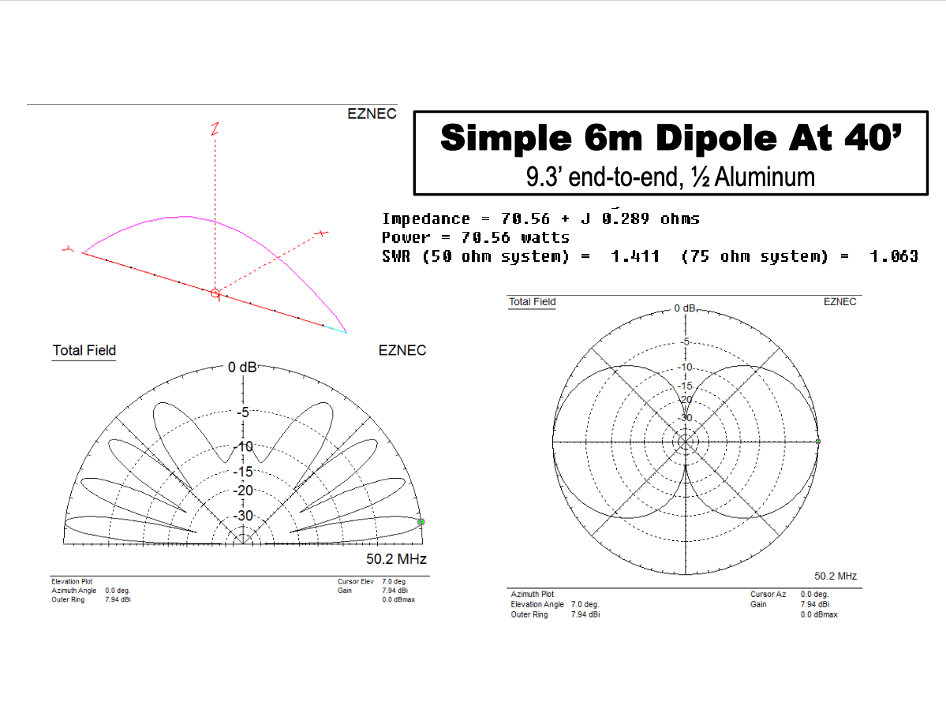
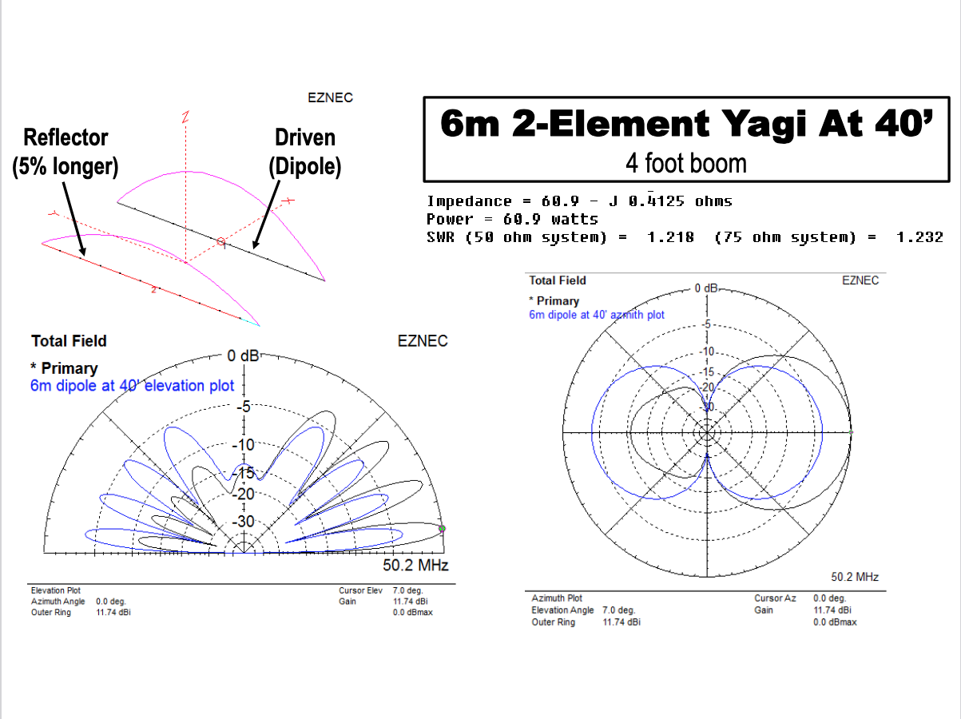
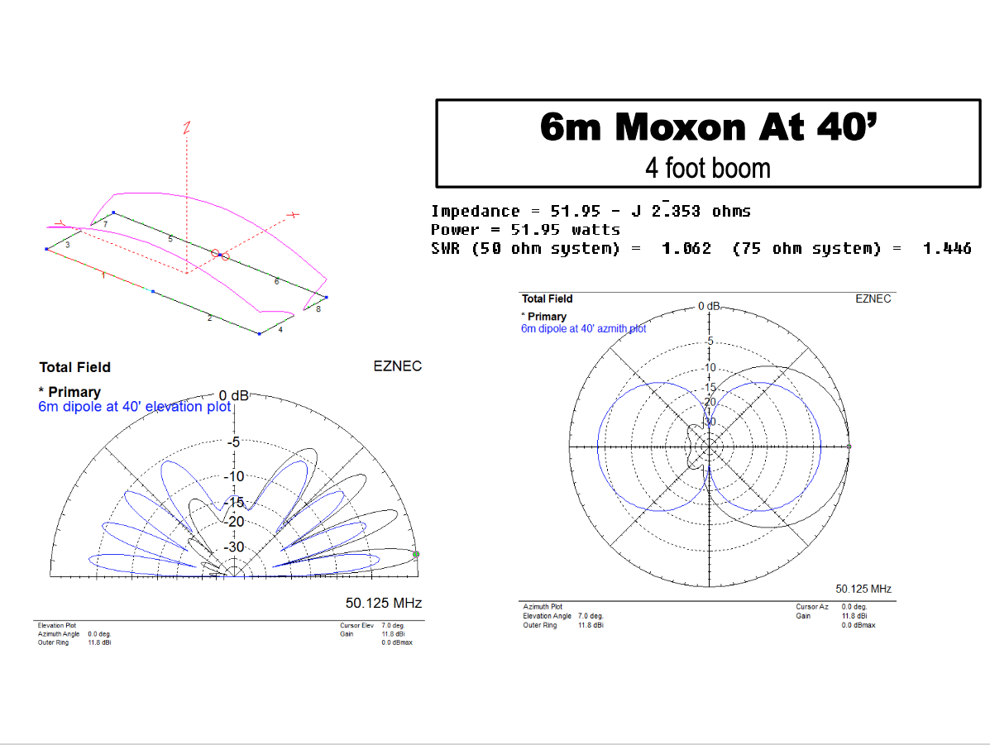
Antenna Height Above ground level – Antenna HAGL
The K2AD $0.02 worth
Very high antennas will have a lower radiation angle
Great for long distance contacts
Lower antennas will have a higher radiation angle
Shorter distance contacts
Is your antenna aimed at the ionized layer that will bounce your signal to work that new grid or new DX?
Don’t forget about ground gain
Check out this presentation by Jon Platt, W0ZQ
https://nlrs.club/docs/2015_Aurora/2015_AU_W0ZQ_Homebrewing%20VHF%20antennas.pdf

Slide 28
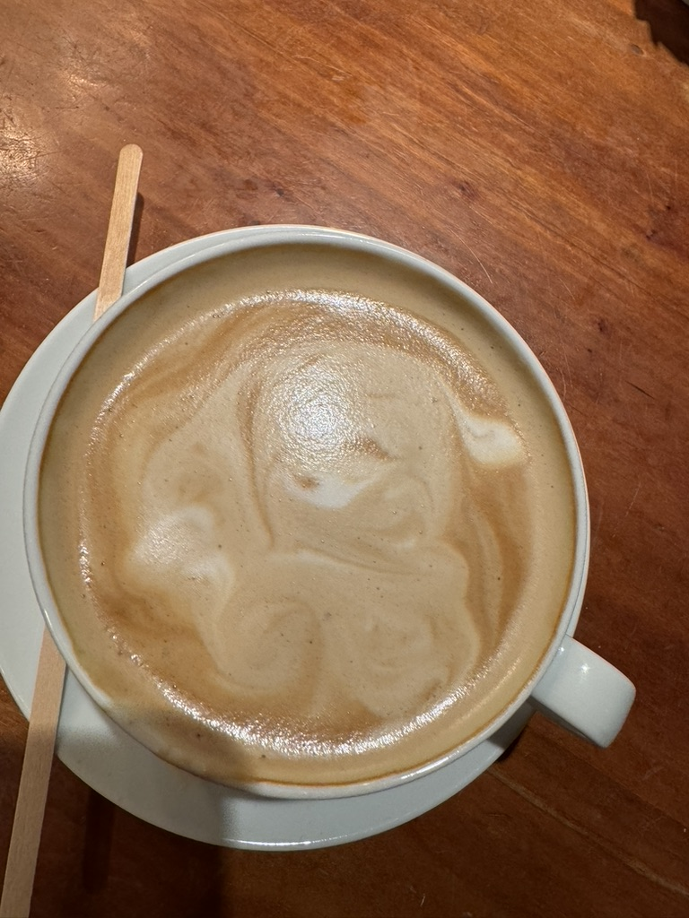
Coffee time
Questions?
Thank you for listening de K2AD

Slide 29
Cushcraft HF Yagis and Verticals

Slide 30
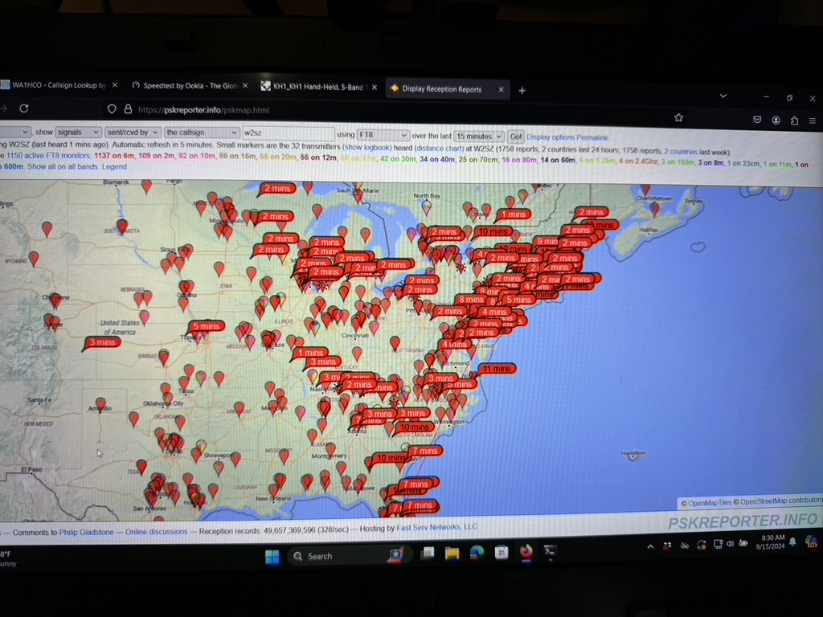
Six Meter yagi and omni antennas
Tomato stake yagis
MOXON
Directive Systems Yagi
Big antennas are great … but

Slide 31
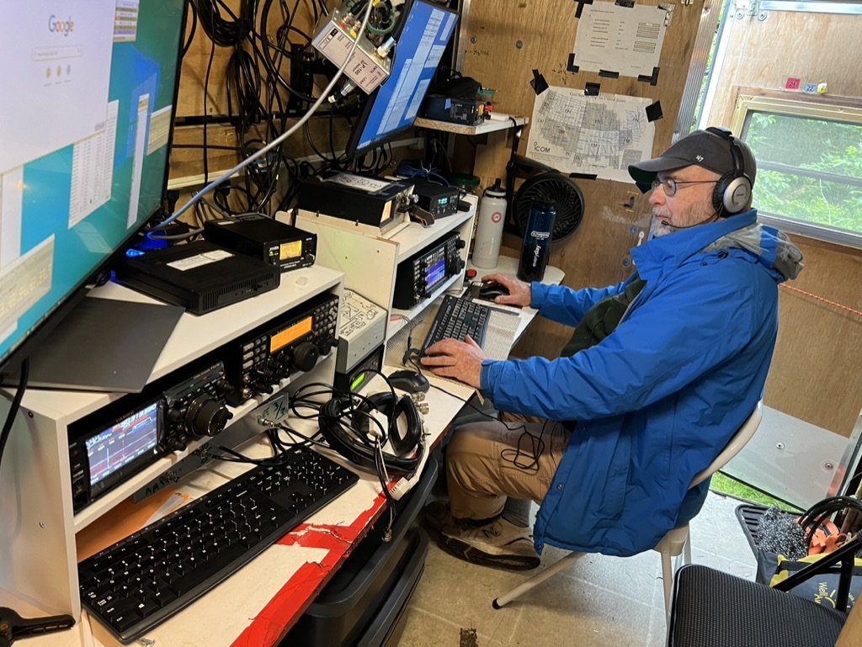
Cheap VHF / UHF Yagis

Slide 32
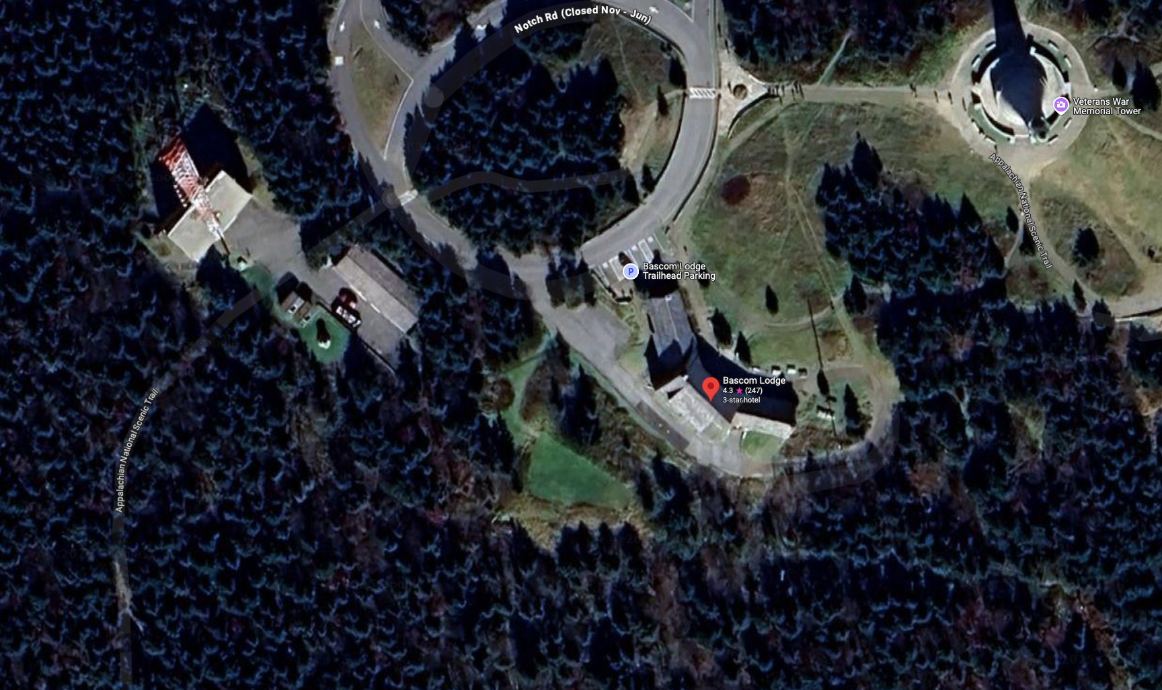
Title
Tomato 2
Tomato 1
Primary
6 / 6 ele

Slide 33
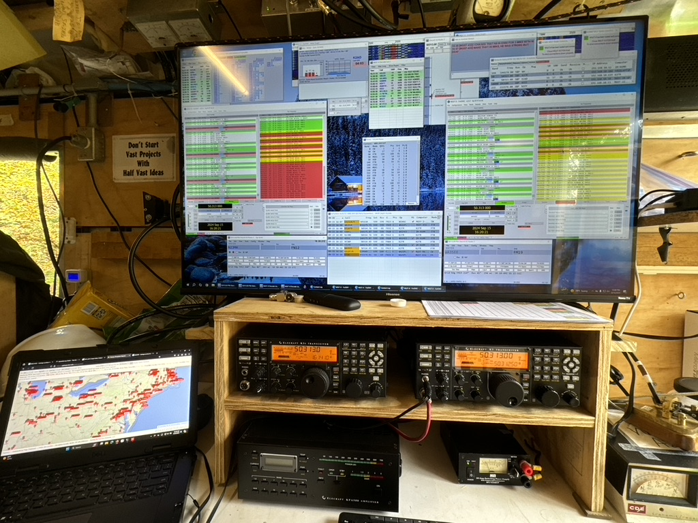
Title

Slide 34
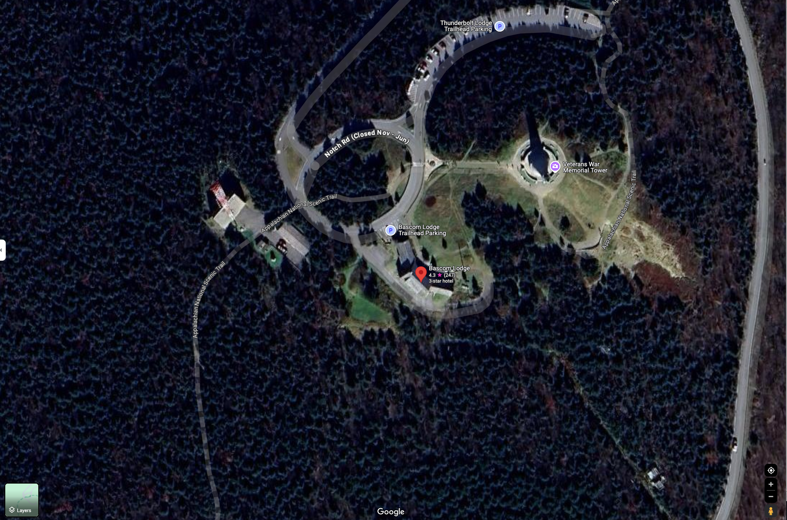
Title

